Slide 1
Step 1
Entry
Step 7
Medical Corner
Step 2
DWAAR
Welcome Back
Step 8
Quarantine
Step 3,4,5
Checks
SOP FOR RE-ENTRY
OF STUDENTS
Step 9 Welcome Kit
Click on the steps
In Powerpoint Presentation mode
Step 6
Medical Corner
Late Arrivals

Slide 2
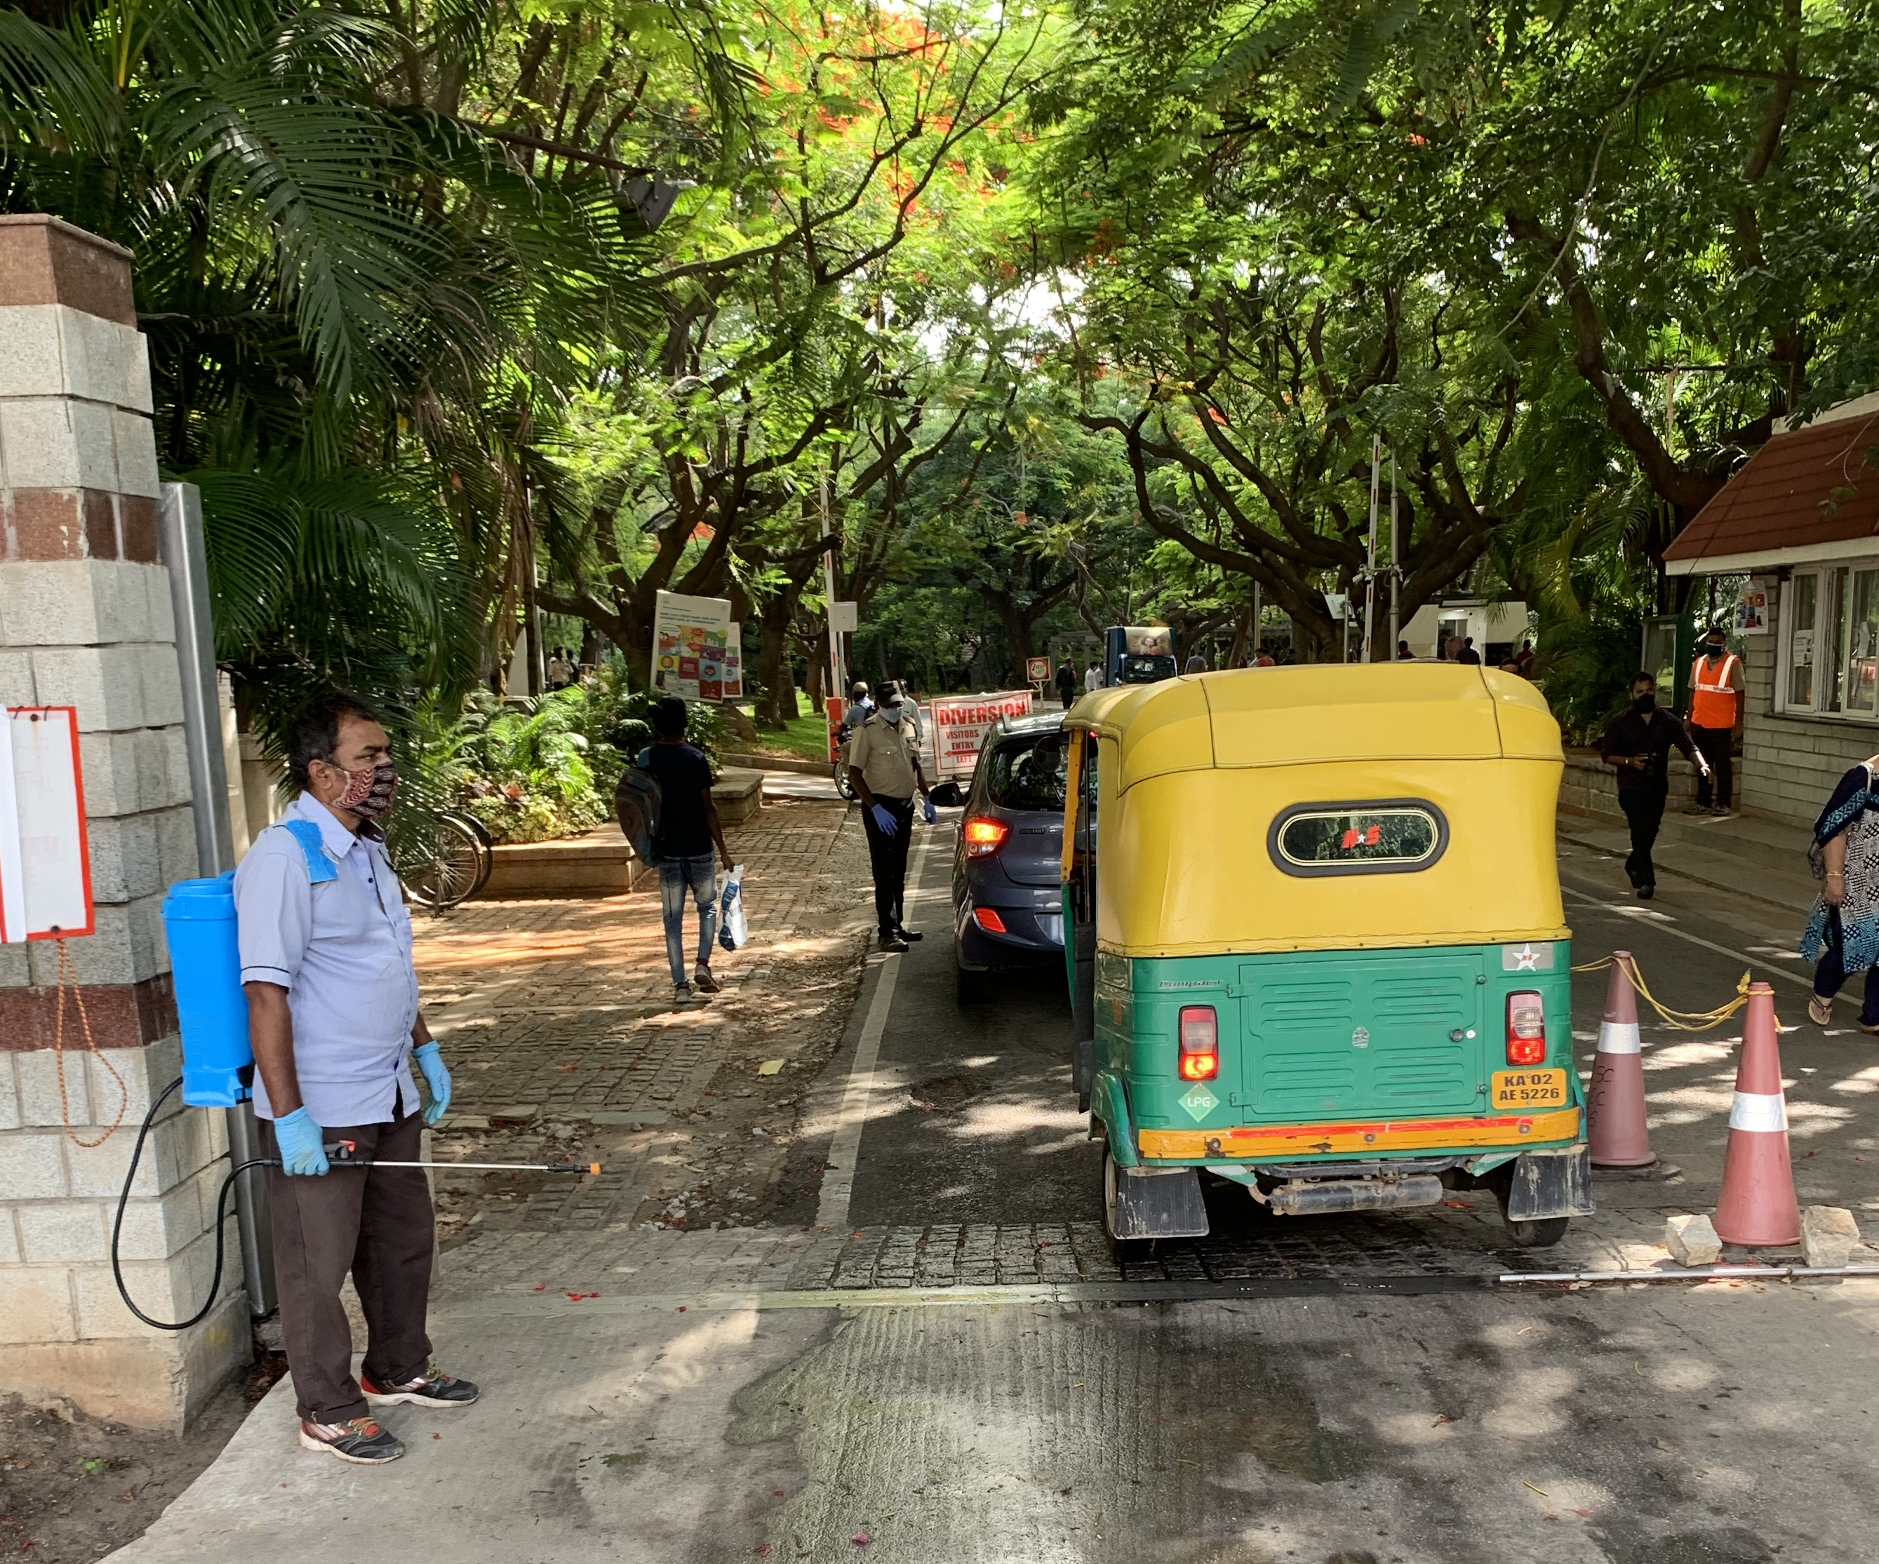
Step 1
Student enters IISc through MAIN GATE
Student enters IISc Main Gate during 9:00 AM – 6:30 PM.
Student shows Student ID and Re-Entry form to security personnel.
Students are directed to go to “Dwaar”

Slide 3
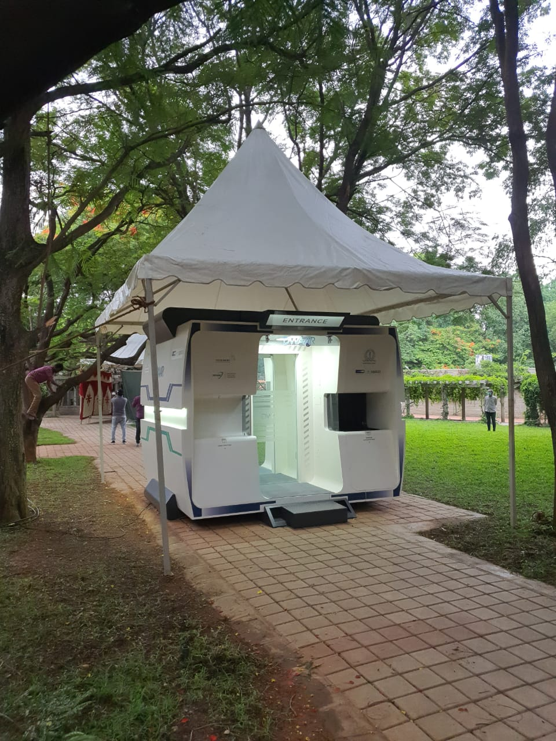
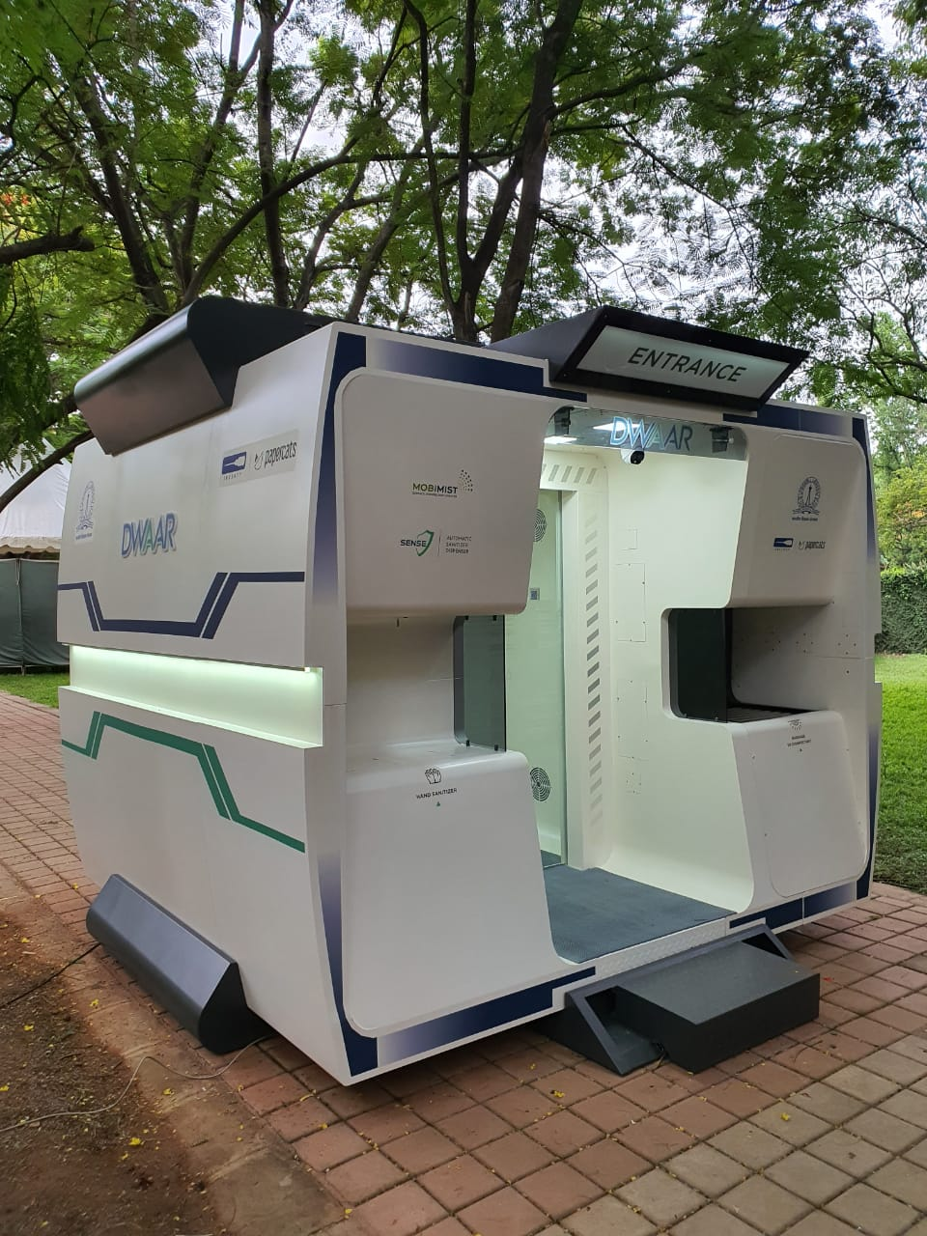
Step 2
Luggage sanitized externally using UV by DWAAR system
Contactless personal temperature noted
Personal Air Shower
DWAAR installed near
Main Gate and Choksi Hall
Click to view video

Slide 4
Step 3
Student’s Re-entry Form checked
Step 4
Student’s Temperature recorded by DWAAR
Students with fever (Temperature above 99°F) sent to Flu clinic at Health Center
Step 5
Luggage to be left in the Luggage holding area near Choksi Hall

Slide 5
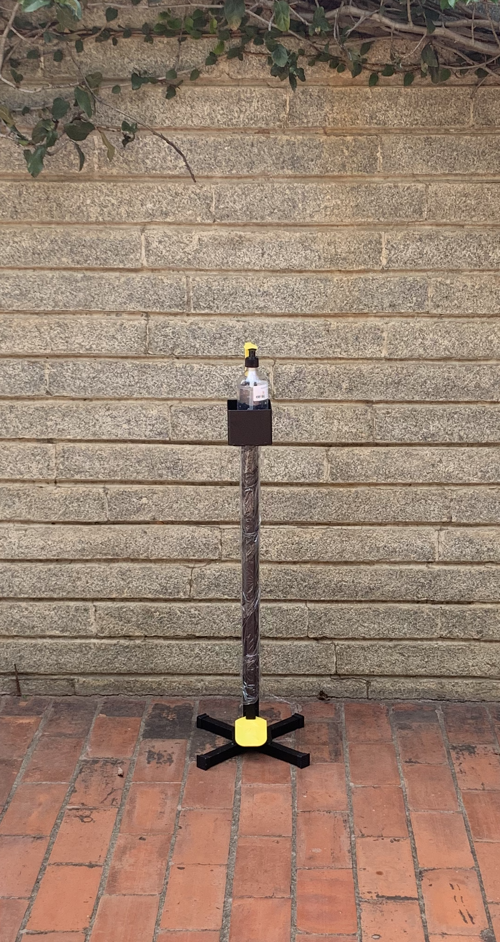
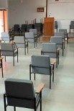
Step 6
Medical Corner@CHOKSI Hall
Students will be seated in Choksi Hall as per Social Distancing norms.
Health Centre Declaration form
provided to students.
Health Center Doctors will be available from 9:00 AM to 6:30 PM.

Slide 6
Step 7
Medical Corner@CHOKSI Hall
Vitals checked by nursing staff.
Screening of forms done by Doctors
stationed at Choksi Hall.
Students cleared by Doctors or
sent to Flu Clinic in Health Center
(in case of flu symptoms), for further examination.

Slide 7
Step 8
Quarantine stamping done for cleared students
Quarantine stamping done for cleared students
14-day Quarantine pass issued which should be carried by the student during the entire period of Quarantine
Quarantine Monitoring Committee is empowered to deal with any violations

Slide 8
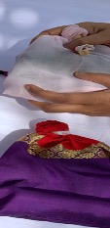
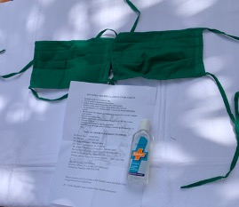
Step 9
Welcome Kit
Welcome kit given
Student goes
to the hostel room
Transvaahan available

Slide 9
Steps for Arrivals during 6:30 PM – 7:00 AM
DO NOT release the vehicle which brought you to IISc.
Report to the main gate where you register your arrival based on the re-entry form.
After the security personnel confirm that the doctor is not available, they will direct you to go to transit accommodation.
Use the vehicle to go to the transit accommodation
KRVH Quarters (on Gymkhana side of the campus) for male students
Student Guest House (near NGH) for female students
Security personnel at each facility will check for temperature and allocate the room.
Each room will have a water can, bed, mattress, 2 bedsheets, pillow, handwash/sanitizer and a mosquito repellant device
Meals will be arranged on request
Student checks out around 8:30 AM the following day and reports to IISc Main Gate for Steps 1-9.
Hostel Office will disinfect the room after student checks out

Slide 10
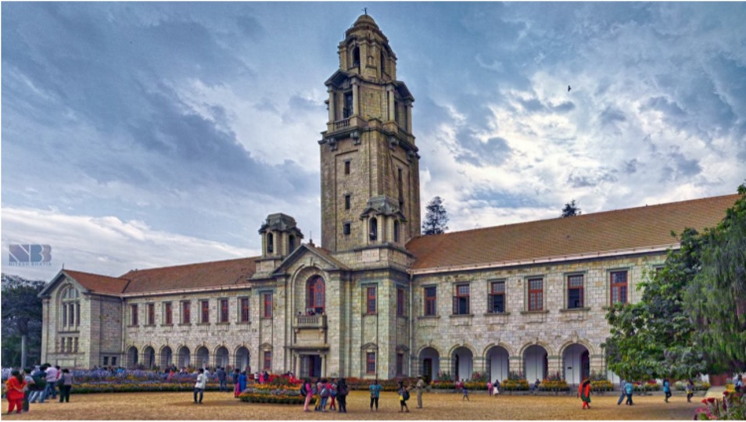
Welcome Back!
We missed you!

